Slide 1
Unit 00 - Lesson 01 - Objectives
Knowledge
Reading: List active reading strategies for college level CS textbooks and explain why they are useful
CS: Describe the rules Java follows when performing mathematical and casting operations on different numerical types
Skills
Reading: In a CS textbook match specific sections of text to example code; create a concept map; utilize a concept map to generate related questions; test related questions in code
CS: Evaluate expressions involving ints, doubles, casting, and basic mathematical operators ( +, -, *, / )

Slide 2
Agenda
Take out HW - code for a boat and a tree
Reading a CS text book
Take CollegeBoard Survey

Slide 3
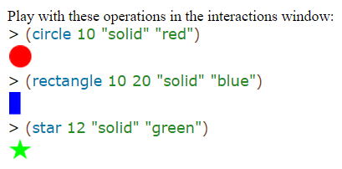
Images represent symbolic data somewhat like strings. To work with images, use the 2htdp/image library. Like strings, you used DrRacket to insert images wherever you would insert an expression into your program, because images are values just like numbers and strings.0 Your programs can also manipulate images with primitive operations. These primitive operations come in three flavors. The first kind concerns the creation of basic images:1 circle produces a circle image from a radius, a mode string, and a color string; ellipse produces an ellipse from two radii, a mode string, and a color string; line produces a line from two points and a color string; rectangle produces a rectangle from a width, a height, a mode string, and a color string; text produces a text image from a string, a font size, and a color string; and triangle produces an upward-pointing equilateral triangle from a size, a mode string, and a color string.2 The names of these operations mostly explain what kind of image they create. All you need to know is that mode strings means either "solid" or "outline" and color strings are strings such as "orange", "black", etc.3

Slide 4
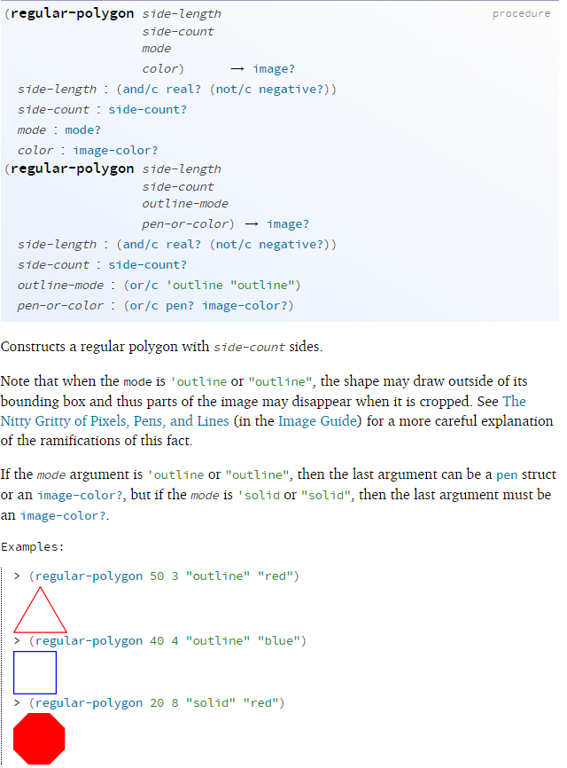
Stop! The above uses a previously-unmentioned operation. Look up its documentation and find out how many more image creation operations there are in BSL. Look up the documentation for regular-polygon. Experiment!

Slide 5
Stop! The above uses a previously-unmentioned operation. Look up its documentation and find out how many more image creation operations there are in BSL. Look up the documentation for regular-polygon. Experiment!

Slide 6
Signature
Purpose statement
Examples

Slide 7
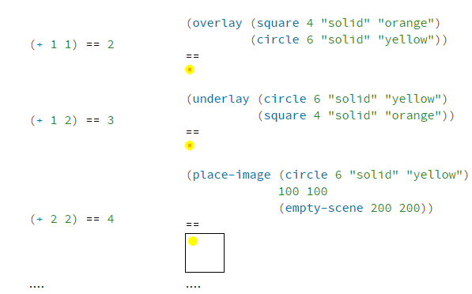
The laws of arithmetic for images are analogous to those for numbers: Again, no image gets destroyed or changed. Like +, these image combinations just make up new images that combine the given ones in the requested manner.

Slide 8
Code | Predicted | Actual
(image-width (circle 10 "solid" "red")) (image-height (rectangle 10 20 "solid" "blue")) (+ (image-width (circle 10 "solid" "red")) (image-height (rectangle 10 20 "solid" "blue")))

Slide 9
Code | Predicted | Actual
(image-width (circle 10 "solid" "red")) (image-height (rectangle 10 20 "solid" "blue")) (+ (image-width (circle 10 "solid" "red")) (image-height (rectangle 10 20 "solid" "blue")))

Slide 10
Important Vocabulary
image symbolic data values anchor point image-primitive type name | flavor

Slide 11
Concept Map (from wikipedia)
A concept map or conceptual diagram is a diagram that depicts suggested relationships between concepts.
It is a graphical tool that designers, engineers, technical writers, and others use to organize and structure knowledge.

Slide 12
image
is an image function example
is an image primitive
(circle 10 “solid” “red”)
circle
is the same kind of function as
image producing operation
rectangle
function name

Slide 13
Related Questions
Question | Code To Test

Slide 14
Unit 00 - Lesson 01 - Objectives
Knowledge
Reading: List active reading strategies for college level CS textbooks and explain why they are useful
CS: Describe the rules Java follows when performing mathematical and casting operations on different numerical types
Skills
Reading: In a CS textbook match specific sections of text to example code; create a concept map; utilize a concept map to generate related questions; test related questions in code
CS: Evaluate expressions involving ints, doubles, casting, and basic mathematical operators ( +, -, *, / )

Slide 15
Unit 00 - Lesson 08 - Homework
Re-Read Textbook
Complete notes from Section 1.4
Study For Quiz
Quiz will be on lesson objectives
Course textbook might have question on the quiz!

